Slide 1
Dense Motion Estimate
CSC 249/449 Spring 2019
http://www.cs.rochester.edu/~cxu22/t/249S19/
Instructor: Chenliang Xu
chenliang.xu@rochester.edu

Slide 2
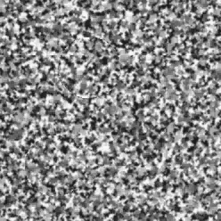
Motion is a powerful perceptual cue
Sometimes, it is the only cue

Slide 3
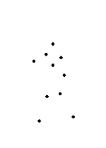
Motion is a powerful perceptual cue
Even “impoverished” motion data can evoke a strong percept
G. Johansson, “Visual Perception of Biological Motion and a Model For Its Analysis", Perception and Psychophysics 14, 201-211, 1973.

Slide 4
Motion is a powerful perceptual cue
Even “impoverished” motion data can evoke a strong percept
G. Johansson, “Visual Perception of Biological Motion and a Model For Its Analysis", Perception and Psychophysics 14, 201-211, 1973.

Slide 5
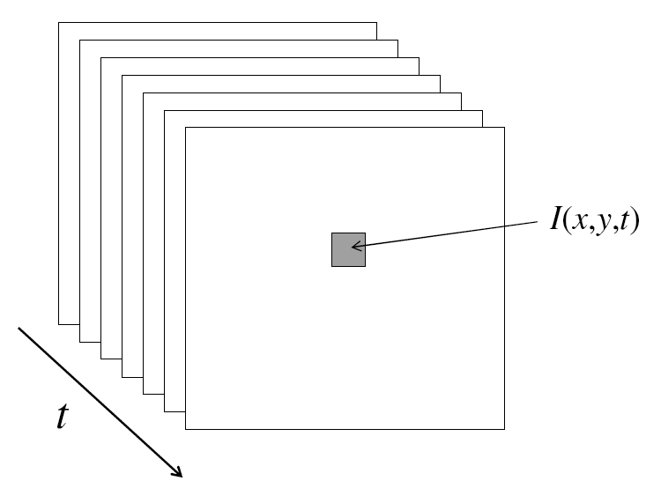
Video
A video is a sequence of frames captured over time
Now our image data is a function of space (x, y) and time (t)

Slide 6
Uses of motion in computer vision
3D shape reconstruction
Video super-resolution, denoising
Video compression
Object segmentation
Learning and tracking of dynamical models
Event and activity recognition
Self-supervised and predictive learning
Etc.

Slide 7
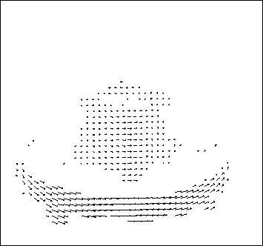
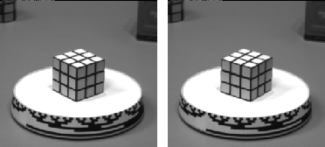
Motion field
The motion field is the projection of the 3D scene motion into the image
Notes:
The same 3D scene motion has different representations in the motion field.

Slide 8
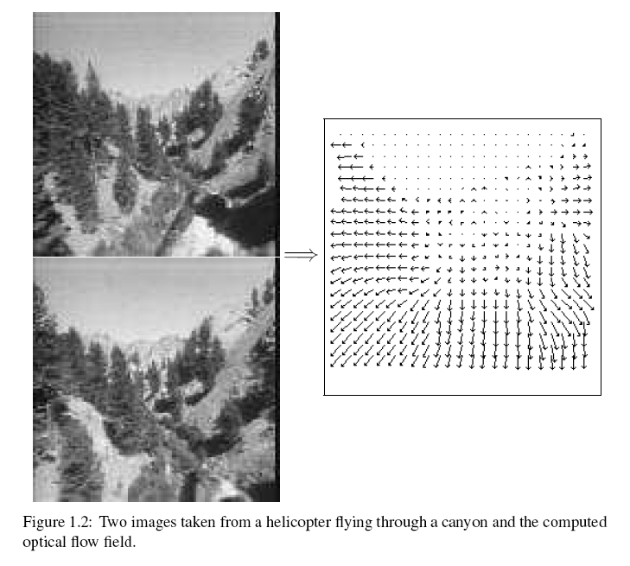
Motion field + camera motion
Length of flow vectors inversely proportional to depth Z of 3d point
points closer to the camera move more quickly across the image plane
Figure from Michael Black, Ph.D. Thesis

Slide 9
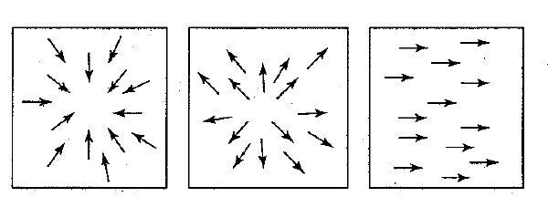
Motion field + camera motion
Zoom out
Zoom in
Pan right to left

Slide 10
Motion estimation techniques
Direct methods
Directly recover image motion at each pixel from spatio-temporal image brightness variations
Dense motion fields, but sensitive to appearance variations
Suitable for video and when image motion is small
Feature-based methods
Extract visual features (corners, textured areas) and track them over multiple frames
Sparse motion fields, but more robust tracking
Suitable when image motion is large (10s of pixels)

Slide 11
Optical flow
Definition: optical flow is the apparent motion of brightness patterns in the image

Slide 12

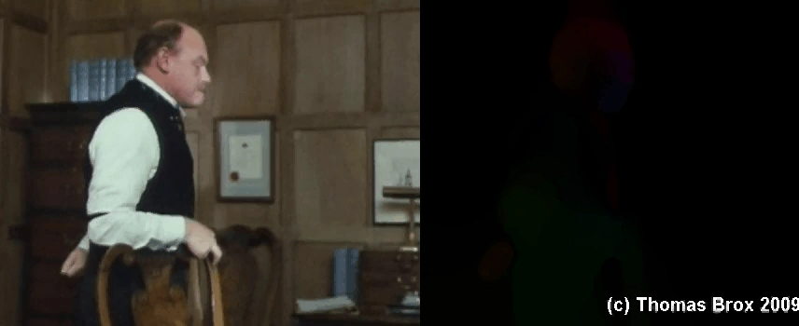
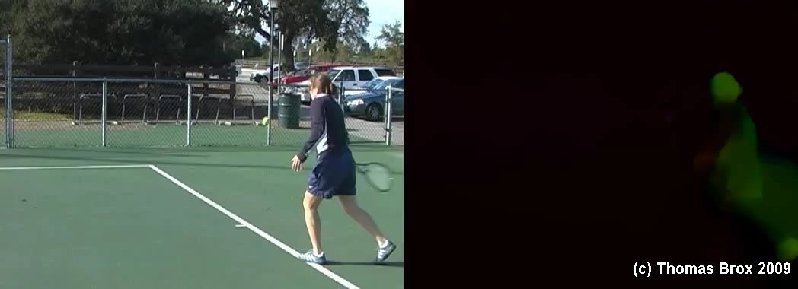
Thomas Brox, large displacement optical flow.
https://lmb.informatik.uni-freiburg.de/research/opticalflow/

Slide 13
Optical flow
Definition: optical flow is the apparent motion of brightness patterns in the image
Ideally, optical flow would be the same as the motion field
Have to be careful: apparent motion can be caused by lighting changes without any actual motion
Notes:
Think about smooth sphere with lighting changes

Slide 14
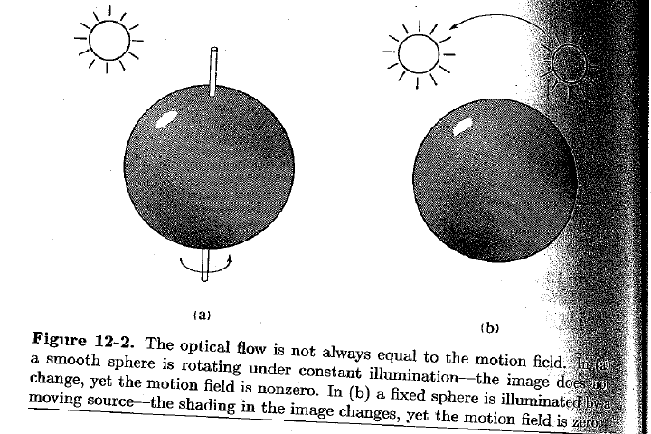
Apparent motion != motion field
Figure from Horn book

Slide 15
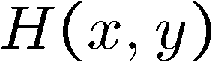
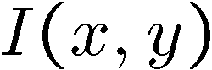
Problem definition: optical flow
How to estimate pixel motion from image H to image I?
Solve pixel correspondence problem
given a pixel in H, look for nearby pixels of the same color in I
Key assumptions
color constancy: a point in H looks the same in I
For grayscale images, this is brightness constancy
small motion: points do not move very far
This is called the optical flow problem

Slide 16
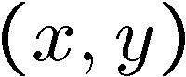
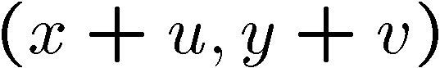
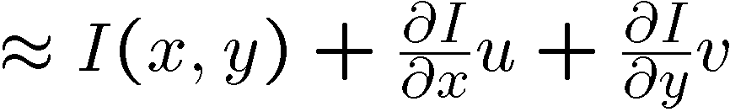
Optical flow constraints
Let’s look at these constraints more closely
brightness constancy: Q: what’s the equation?
small motion:

Slide 17
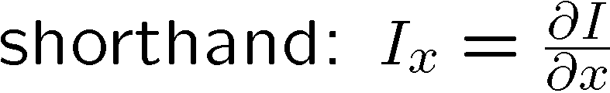


Optical flow equation
Combining these two equations

Slide 18
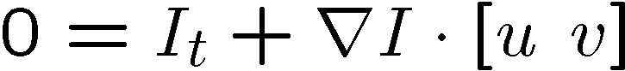
Optical flow equation
Q: how many unknowns and equations per pixel?

Slide 19
The aperture problem
Perceived motion

Slide 20
The aperture problem
Actual motion

Slide 21
The brightness constancy constraint
How many equations and unknowns per pixel?
One equation, two unknowns
Intuitively, what does this constraint mean?
The component of the flow perpendicular to the gradient (i.e., parallel to the edge) is unknown
gradient
(u,v)
If (u, v) satisfies the equation, so does (u+u’, v+v’) if
(u’,v’)
(u+u’,v+v’)
edge

Slide 22

The barber pole illusion
http://en.wikipedia.org/wiki/Barberpole_illusion

Slide 23

The barber pole illusion
http://en.wikipedia.org/wiki/Barberpole_illusion

Slide 24
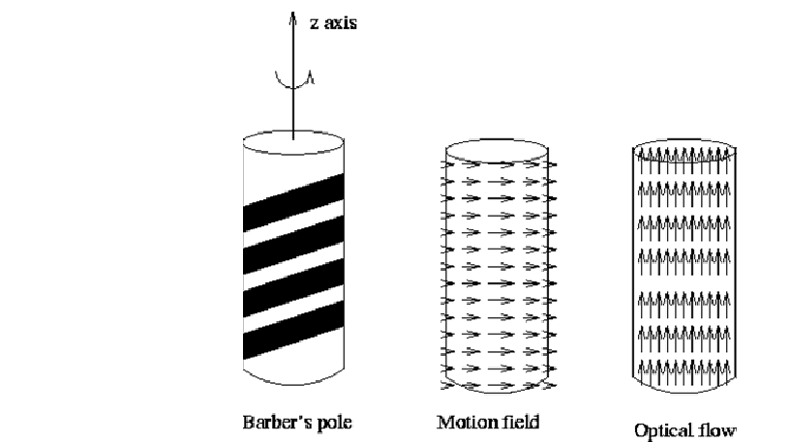


The barber pole illusion
http://en.wikipedia.org/wiki/Barberpole_illusion

Slide 25
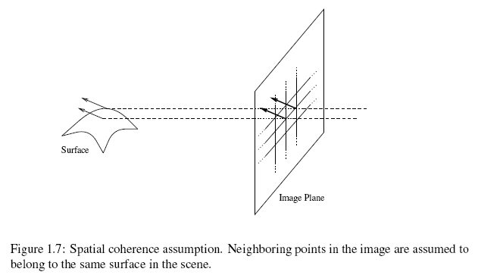
Solving the aperture problem
How to get more equations for a pixel?
Spatial coherence constraint: pretend the pixel’s neighbors have the same (u,v)
Figure by Michael Black

Slide 26
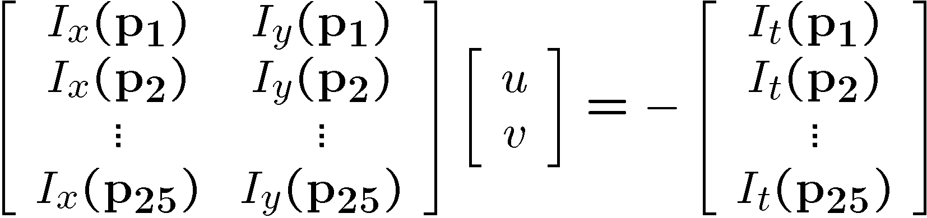




Solving the aperture problem
How to get more equations for a pixel?
Spatial coherence constraint: pretend the pixel’s neighbors have the same (u,v)
If we use a 5x5 window, that gives us 25 equations per pixel
Slide credit: Steve Seitz

Slide 27




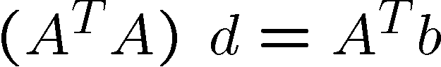

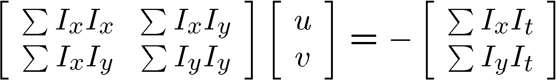
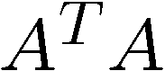
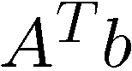
Solving the aperture problem
Prob: we have more equations than unknowns
Solution: solve least squares problem
minimum least squares solution given by solution (in d) of:
The summations are over all pixels in the K x K window
This technique was first proposed by Lucas & Kanade (1981)
Slide credit: Steve Seitz

Slide 28
Conditions for solvability
When is this solvable?
A^{T}A should be invertible
A^{T}A should not be very small
eigenvalues λ₁ and λ₂ of A^{T}A should not be very small
A^{T}A should be well-conditioned
λ₁/ λ₂ should not be too large (λ₁ = larger eigenvalue)
Slide by Steve Seitz, UW

Slide 29
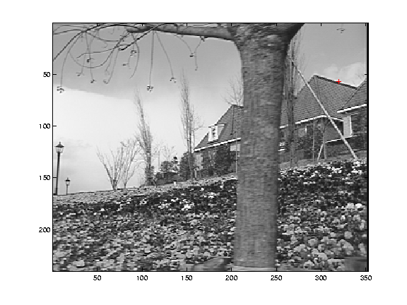
Edge
gradients very large or very small
large λ₁, small λ₂

Slide 30
Low-texture region
gradients have small magnitude
small λ₁, small λ₂

Slide 31
High-texture region
gradients are different, large magnitudes
large λ₁, large λ₂

Slide 32
Errors in Lucas-Kanade
The motion is large (larger than a pixel)
A point does not move like its neighbors
Brightness constancy does not hold
Notes:
Iterative refinement:
Estimate velocity at each pixel using one iteration of Lucas and Kanade estimation
Warp one image toward the other using the estimated flow field
Refine estimate by repeating the process

Slide 33
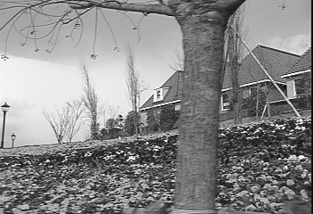
“Flower garden” example
* From Khurram Hassan-Shafique CAP5415 Computer Vision 2003

Slide 34
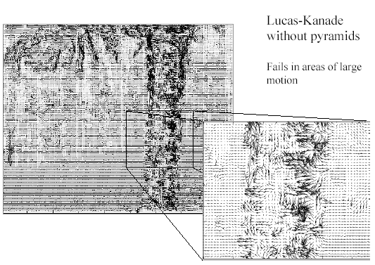
“Flower garden” example
Lucas-Kanade fails in areas of large motion
* From Khurram Hassan-Shafique CAP5415 Computer Vision 2003

Slide 35
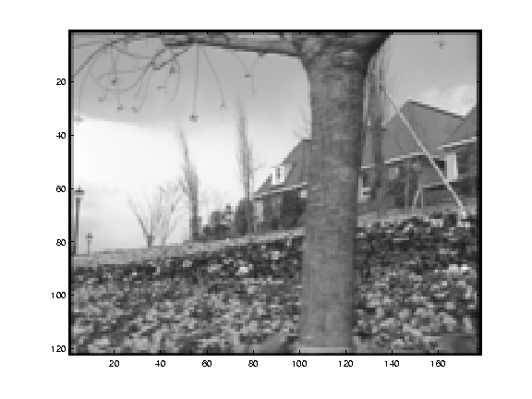
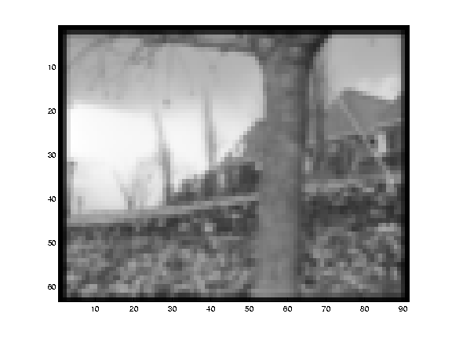
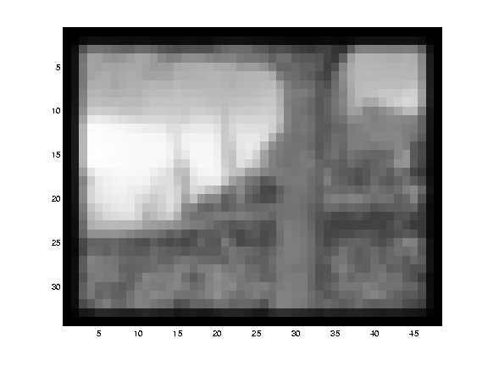
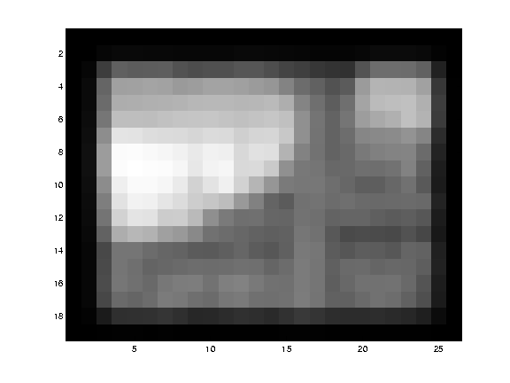
Multi-resolution estimation
* From Khurram Hassan-Shafique CAP5415 Computer Vision 2003

Slide 36
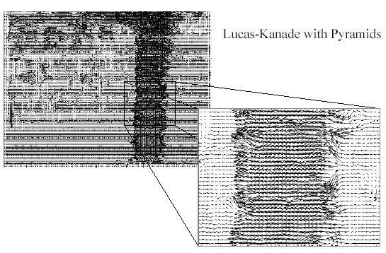
Multi-resolution estimation
With multi-resolution estimation
* From Khurram Hassan-Shafique CAP5415 Computer Vision 2003

Slide 37
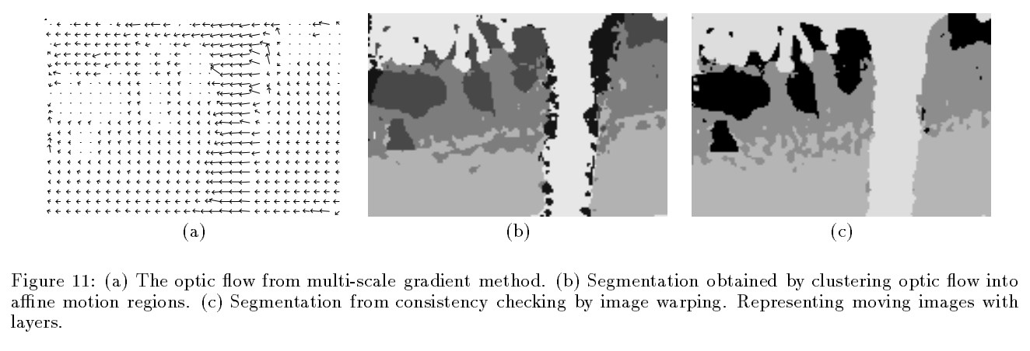
Fixing the errors in Lucas-Kanade
The motion is large (larger than a pixel)
Multi-resolution estimation, iterative refinement
Feature matching
A point does not move like its neighbors
Motion segmentation
J. Wang and E. Adelson, Representing Moving Images with Layers, IEEE Transactions on Image Processing, 1994
Notes:
Iterative refinement:
Estimate velocity at each pixel using one iteration of Lucas and Kanade estimation
Warp one image toward the other using the estimated flow field
Refine estimate by repeating the process

Slide 38
Fixing the errors in Lucas-Kanade
The motion is large (larger than a pixel)
Multi-resolution estimation, iterative refinement
Feature matching
A point does not move like its neighbors
Motion segmentation
Brightness constancy does not hold
Feature matching
Notes:
Iterative refinement:
Estimate velocity at each pixel using one iteration of Lucas and Kanade estimation
Warp one image toward the other using the estimated flow field
Refine estimate by repeating the process

Slide 39
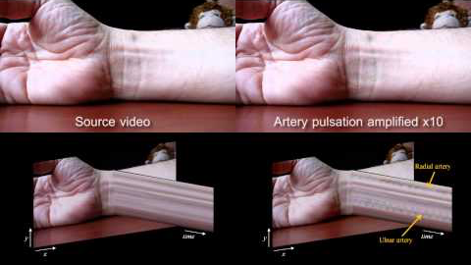
Video Magnification
http://people.csail.mit.edu/mrub/vidmag/

Slide 40
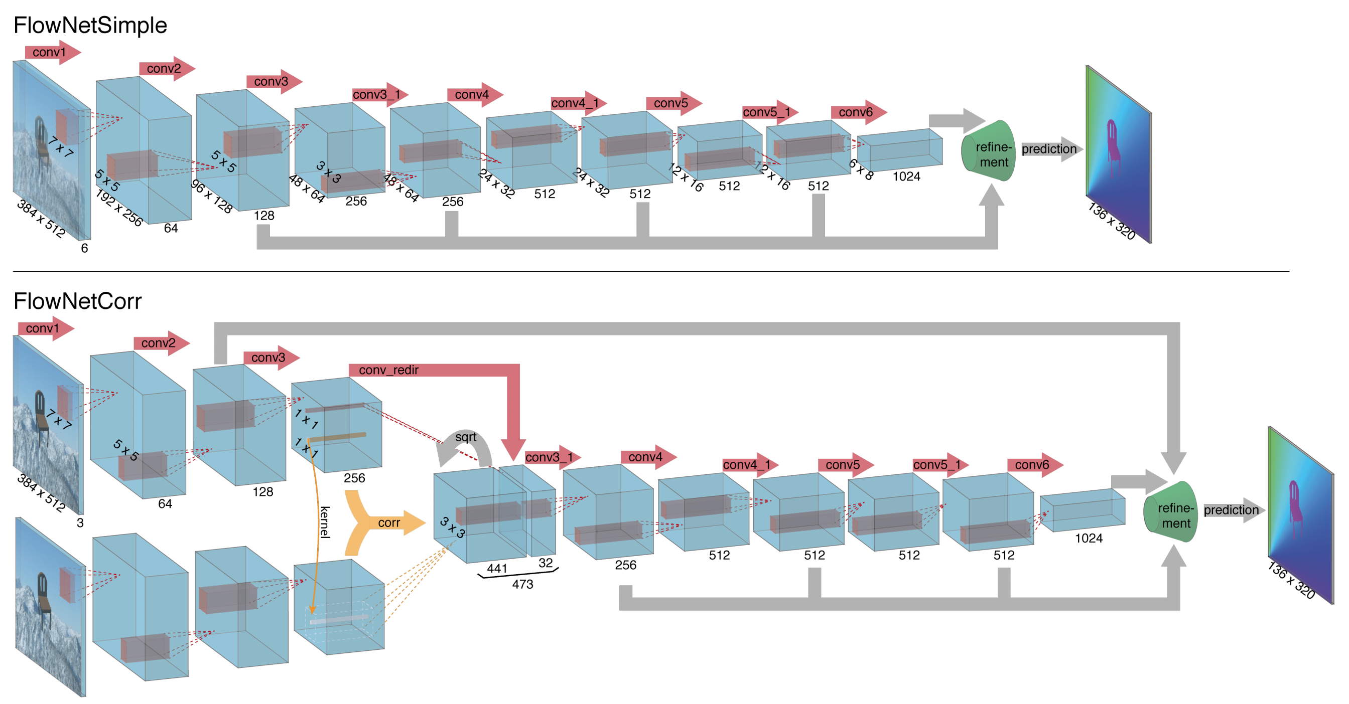
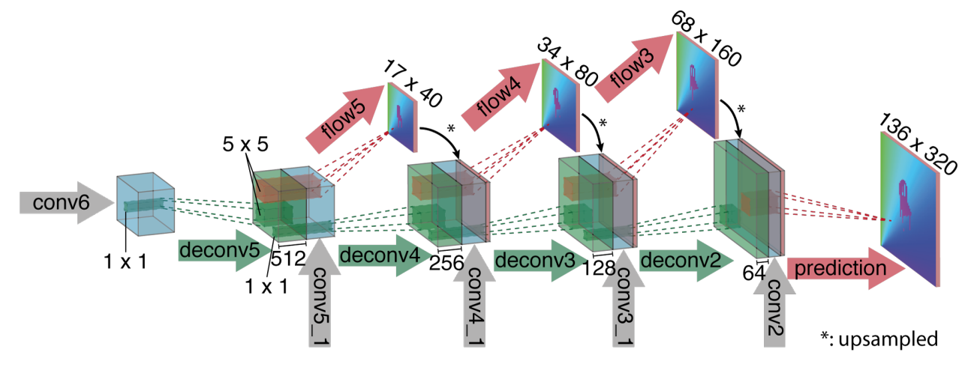
FlowNet: Learning Optical Flow with Convolutional Networks
Refinement Net:
Fischer et al. ICCV 2015

Slide 41
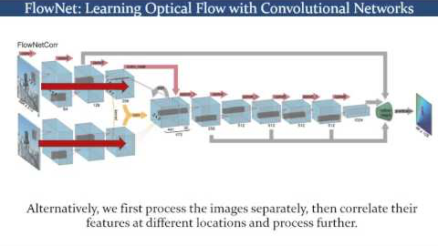
FlowNet: Learning Optical Flow with Convolutional Networks
https://www.youtube.com/watch?v=g-peWXaQnQc

